Slide 1
Venture Tribe Survey Responses Insights.

Slide 2
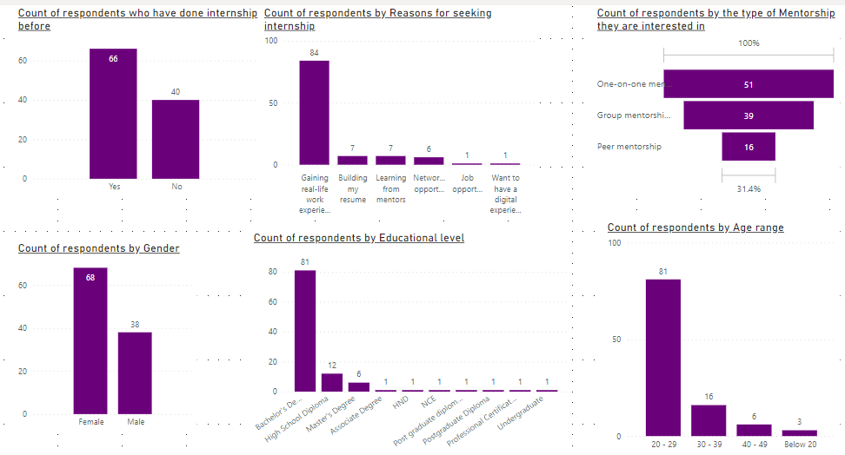
TOTAL COUNT OF INDIVIDUAL VARIABLES

Slide 3
TOTAL COUNT OF INDIVIDUAL VARIABLES
From the visual data, the total number of respondents was 106, comprising:
66 individuals who had completed an internship before, and 40 who had not.
68 females and 38 males.
Regarding the reasons for seeking an internship:
84 respondents aimed to gain real-life experience.
7 sought to build their resume.
7 hoped to learn from mentors.
6 sought networking opportunities.
1 person aimed for a job opportunity.
1 person sought digital experience in addition to traditional experience.
Concerning educational level:
81 held a Bachelor's degree.
12 had a High School Diploma.
6 held a Master's degree.
1 had an Associate degree.
1 had an HND (Higher National Diploma).
1 had an NCE (National Certificate of Education).
1 held a Postgraduate Diploma in Education.
1 held a Postgraduate Diploma.
1 had a Professional Certificate.

Slide 4
CONTINUATION
1 was an Undergraduate.
Regarding preferred mentorship:
51 opted for one-on-one mentorship.
39 preferred group mentorship.
16 chose peer mentorship.
Lastly, the age distribution was:
81 respondents were between 20-29 years old.
16 were between 30-39 years old.
6 were between 40-49 years old.
3 were below 20 years old.

Slide 5
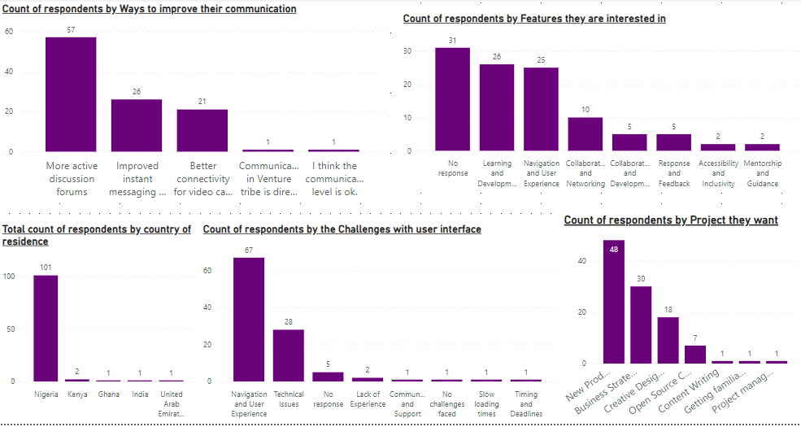
TOTAL COUNT OF INDIVIDUAL VARIABLES

Slide 6
TOTAL COUNT OF RESPONDENTS BY THE DIFFERENT VARIABLES
From the count of ways to improve communication:
57 people are interested in more active discussion forums.
26 people want an improved instant messaging system.
21 people desire better connectivity for video calls.
1 person thinks the communication in Venture Tribe is direct.
1 person concluded that the communication in Venture Tribe has been okay.
From the count of respondents by country of residence:
Nigeria: 101
Kenya: 2
Ghana: 1
India: 1
United Arab Emirates: 1
From the count of challenges with the user interface:
87 people experienced Navigation and user experience issues.
28 people faced Technical issues.
5 people did not respond.

Slide 7
CONTINUATION
2 people lacked experience.
1 person lacked communication and support.
1 person has not faced any challenges.
1 person experienced slow loading times.
1 person faced issues with timing and deadlines.
From the count of projects respondents are interested in:
48 people are interested in New Product Development projects.
30 people are interested in Business Strategy projects.
18 people are interested in Creative Design projects.
7 people are interested in Open Source Community projects.
1 person is interested in Content Writing.

Slide 8
CONTINUATION
1 person wants to get familiar with real-life data.
1 person is interested in Project Management.
From the count of features respondents would like to have on the Venture Tribe website:
31 people did not respond.
26 people are interested in Learning and Development features.
25 people want features that improve Navigation and user experience.
10 people want features that provide Collaboration and Networking.
5 people want Collaboration and Development features.
5 people want Responses and Feedback features.
2 people want Accessibility and Inclusivity features.
2 people want Mentorship and Guidance features

Slide 9
INSIGHT OBSERVED AMONG VARIABLES
. Painful Experiences in Previous Internships
20 respondents who had done internships before didn't share their painful experiences.
Among those who responded:
11 faced Navigation and user experience issues.
8 encountered Accessibility and visibility issues.
7 experienced Technical issues.
6 faced Responses and feedback challenges.
4 had Communication and support issues.
3 had Customization and feedback issues.
2 faced Accessibility and visibility issues.
Educational Level vs. Reasons for Seeking Internship
Gaining Real-Life Experience:
Associate's degree: 1.19%
Bachelor's degree: 78.57%
High school diploma: 11.9%

Slide 10
CONTINUATION
High school diploma: 11.9%
HND: 1.19%
Master's degree: 3.37%
Postgraduate: 1.19%
Postgraduate (Education): 1.19%
Certificate of completion: 1.19%
Building Resume:
Bachelor's degree: 71.43%
High school diploma: 28.57%
Learning from Mentor:
Bachelor's degree: 71.43%
Master's degree: 14.29%
NCE: 14.29%
Networking Opportunities:
Bachelor's degree: 66.67%
Master's degree: 16.67%
Post diploma: 16.67%
Job Opportunities:
Bachelor's degree: 100%
Digital Experience:
Master's degree: 100%

Slide 11
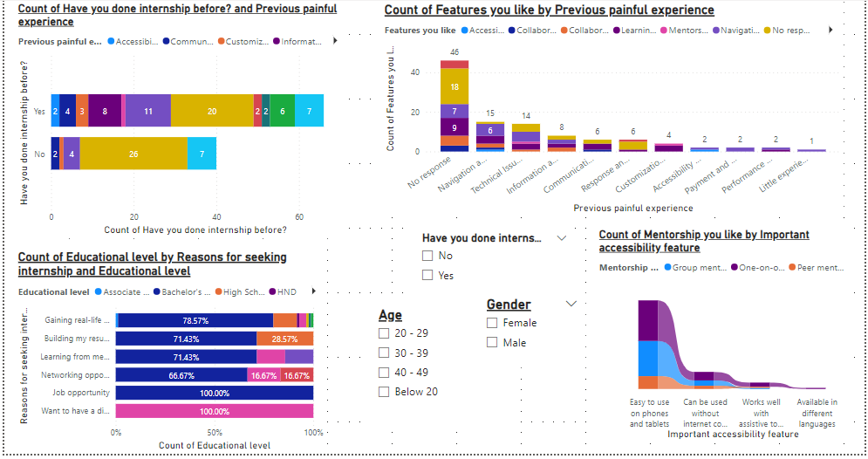
RELATIONSHIP BETWEEN THE VARIABLES

Slide 12
INSIGHT OBSERVED AMONG VARIABLES
Features Respondents Are Interested In, Based On Previous Painful Experiences
Navigation and User Experience (11 respondents):
5 people want Navigation and user experience features
2 people want Learning and development features
2 people want Collaboration and networking features
1 person wants Collaboration and development features
1 person wants Accessibility and inclusivity features
Information and Resources (6 respondents):
2 people didn't respond
2 people want Navigation and user experience features
2 people want Learning and development features
2 people want Collaboration and networking features
Technical Issues (7 respondents):
3 people didn't respond
3 people want Navigation and user experience features
1 person wants Learning and development features
Response and Feedback (6 respondents):
1 person wants Response and feedback features
4 people didn't respond
1 person wants Learning and development features

Slide 13
CONTINUATION
Communication and Support (4 respondents):
1 person didn't respond
2 people want Learning and development features
1 person wants Collaboration and development features
Customization and Feedback (3 respondents):
All 3 want Learning and development features
Accessibility and Visibility (2 respondents):
1 person wants Navigation and user experience features
1 person wants Accessibility and inclusivity features
Payment and Incentive, Performance and Reliability, and Little Experience
Payment and Incentive (2 respondents):
Both want Navigation and user experience features
Performance and Reliability (2 respondents):
1 person wants Navigation and user experience features
1 person wants Learning and development features
Little Experience (1 respondent):
Wants Navigation and user experience features

Slide 14
INSIGHT OBSERVED AMONG VARIABLES
Mentorship and Accessibility Features
Easy to use on phones:
One-on-one mentorship: 38 respondents
Group mentorship: 33 respondents
Peer mentorship: 12 respondents
Can be used without internet connection:
One-on-one mentorship: 8 respondents
Group mentorship: 5 respondents
Peer mentorship: 3 respondents
Work well with assistive tools (screen reader):
One-on-one mentorship: 4 respondents
Group mentorship: 1 respondent
Peer mentorship: 1 respondent
Available in different languages:
One-on-one mentorship: 1 respondent

Slide 15
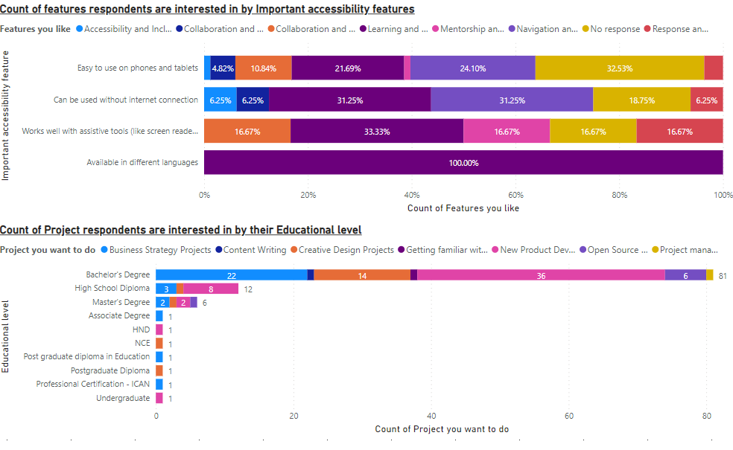
INSIGHT OBSERVED AMONG VARIABLES

Slide 16
INSIGHT OBSERVED AMONG VARIABLES
Features by Accessibility Features
Easy to use on phones:
Accessibility and inclusive features: 1.2%
Collaboration and development: 4.82%
Collaboration and networking: 10.84%
Learning and development: 21.67%
Mentorship and guidance: 1.2%
Navigation and user experience: 24.10%
No response: 32.53%
Response and feedback: 3.61%
Can be used without internet connection:
Accessibility and inclusive features: 6.25%
Collaboration and development: 6.25%
Learning and development: 31.25%
Navigation and user experience: 31.25%
No response: 18.75%
Response and feedback: 6.25%
Work well with assistive tools (screen reader):
Collaboration and development: 16.67%
Learning and development: 33.33%

Slide 17
CONTINUATION
Mentorship and guidance: 16.67%
No response: 16.67%
Response and feedback: 16.67%
Availability in different languages:
Learning and development: 100%
Projects by Educational Level
Bachelor's degree (81 respondents):
Business strategy project: 22
Content writing: 1
Creative design: 14
Real-life data: 1
New product development: 36
Open source project: 6
Project management: 1
High school diploma (12 respondents):
Business strategy project: 3
Creative design: 1
New product project: 8

Slide 18
CONTINUATION
Associate degree (1 respondent):
Business strategy project: 1
HND (1 respondent):
New product development: 1
NCE (1 respondent):
Creative design: 1
Postgraduate diploma (1 respondent):
Creative design: 1
Professional certificate (1 respondent):
Business strategy project: 1
Undergraduate (1 respondent):
New product development: 1

Slide 19
CONCLUSION FROM THE INSIGHT
Key Findings:
Internship Experience: Most respondents (66) have done internships before, and they faced challenges like navigation and user experience issues, technical issues, and communication and support issues.
Reasons for Seeking Internship: The majority (84) want to gain real-life experience, while others seek to build their resume, learn from mentors, or explore networking opportunities.
Educational Level: Bachelor's degree holders (81) dominate the respondents, followed by high school diploma holders (12) and others.
Mentorship: One-on-one mentorship (51) is the most preferred, followed by group mentorship (39) and peer mentorship (16).
Accessibility Features: Respondents desire features like easy-to-use phones, offline access, screen reader compatibility, and availability in different languages.
Project Interests: New product development (48) is the most popular project interest, followed by business strategy (30), creative design (18), and others.

Slide 20
Insights:
Improving User Experience: Addressing navigation and user experience issues is crucial for internship platforms.
Mentorship Programs: Offering one-on-one mentorship and group mentorship can enhance the internship experience. Because mentorship plays a crucial role in providing real-life experience and guiding project interests.
Accessibility: Incorporating accessibility features can expand the platform's reach and inclusivity. Because accessibility features are essential for inclusivity and catering to diverse educational backgrounds and project interests.
Project Variety: Providing diverse project opportunities can cater to different interests and skills.
Internship experience, project interests, and mentorship preferences are related to educational level.
Mentorship, accessibility features, and educational level are interconnected and impact project interests
Desirable Features:
Learning and Development Resources: Offer relevant resources, tutorials, and courses to support interns' learning and growth.
Collaboration Tools: Incorporate tools for collaboration, feedback, and communication among interns, mentors, and team members.
Gamification and Incentives: Consider gamification elements, rewards, or incentives to motivate interns and encourage engagement.
Feedback Mechanism: Establish a feedback system for interns to provide input on their experience, suggestions, and areas for improvement.
Career Development: Provide resources and guidance for career development, resume building, and job search support.

Slide 21
RECOMMENDATIONS:
Enhance User Experience: Invest in user experience design and testing to address navigation and technical issues.
Incorporate Accessibility Features: Implement accessibility features to ensure inclusivity and expand the platform's reach.
Offer Diverse Projects: Provide a range of projects to cater to different interests and skills, ensuring a comprehensive internship experience
User-Friendly Navigation and Experience: Ensure easy navigation, clear instructions, and a responsive design for a seamless user experience.
Mentorship Programs: Offer one-on-one, group, and peer mentorship options to cater to different learning styles and preferences.
Accessibility Features: Incorporate features like easy-to-use phones, offline access, screen reader compatibility, and availability in different languages to ensure inclusivity.
Project Showcase: Allow interns to showcase their projects and accomplishments to facilitate learning and feedback.
Real-Life Experience: Provide opportunities for interns to work on real-life projects, case studies, or simulations to gain practical experience.
Nice-to-Have Features:
Social Network: Create a social network for interns to connect, share experiences, and build relationships.
Event Calendar: Host webinars, workshops, or events and display them on a calendar for interns to participate and engage.
Blogging Platform: Allow interns to share their experiences, insights, and knowledge through a blogging platform.
Recognition and Rewards: Recognize and reward outstanding interns, mentors, or projects to foster a sense of community and achievement.

